Slide 1
An Urban Truck Scheduling and Routing Problem
By Zeyu Liu, Zefeng Lv, Rui Zhou

Slide 2
Background
Assumption
Math Model
Anylogic Model
How we code
Future to Do

Slide 3

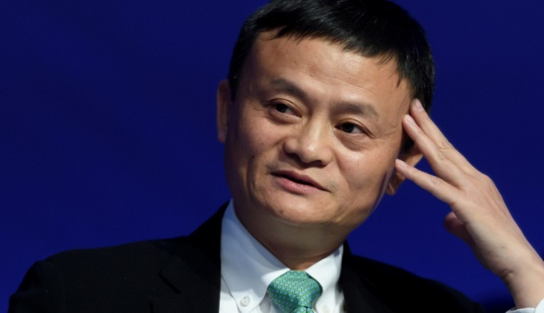

Slide 4
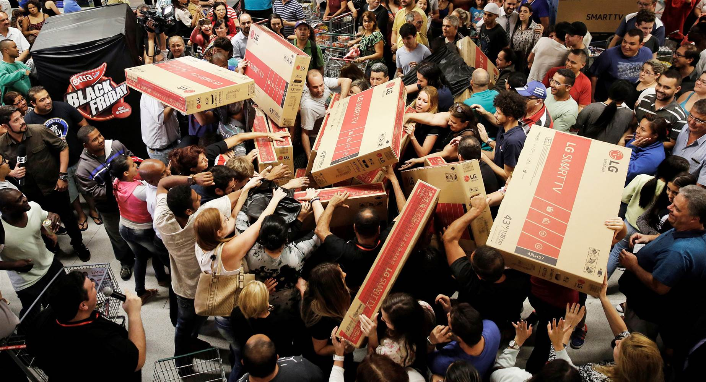

Slide 5
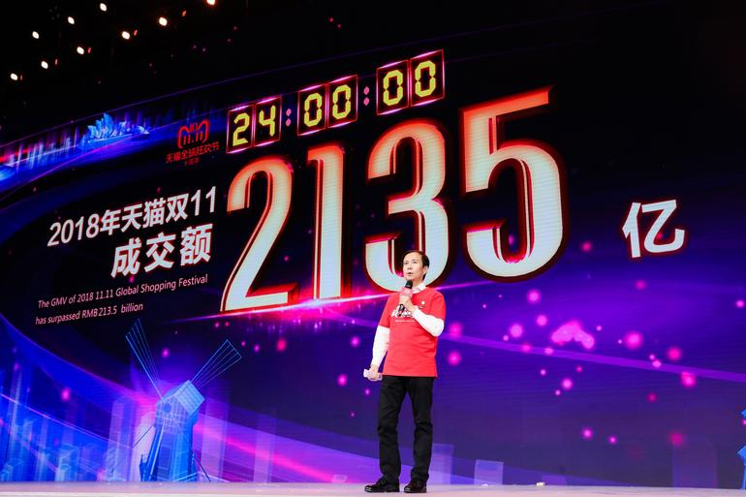

Slide 6
Double Eleven
10 billion yuan in 125 seconds ($ 1.4 billion)
213.5 billion yuan in 24 hours ($ 30.5 billion)
812 million goods
2 to 7 days

Slide 7

Jing Dong
Better quality
Better logistics (next day delivery)

Slide 8
What’s our problem?
One distribution center
More than 1000 customers
Decisions
How many trucks?
What’s the route?

Slide 9
Objective function
Minimize the total cost: fixed cost, traveling cost, waiting cost
Constraints
Driving range
Weight and volume capacity
Time window
Others: Recharge, multi-trips, heterogeneous fleet.

Slide 10
Data sample
Node ID | Longitude | Latitude | Package Weight (tons) | Package Volume (cubic meters) | Earliest Time | Latest Time
1 | 116.242043 | 40.072630 | 0.20760 | 0.3666 | 09:00 | 12:00
2 | 116.403595 | 39.872945 | 0.05863 | 0.1687 | 13:30 | 14:00
3 | 116.186289 | 40.016361 | 0.03645 | 0.0745 | 13:00 | 15:00
4 | 116.508011 | 39.826296 | 0.02595 | 0.0542 | 09:00 | 10:00
5 | 116.130997 | 39.825921 | 0.0198 | 0.1117 | 11:00 | 13:30
… | … | … | … | … | … | …
50 | 116.214509 | 40.122890 | 0.01697 | 0.0260 | 11:00 | 12:00

Slide 11
Data sample
From Node | To Node | Distance (kilometers) | Transport Time (minutes)
0 | 1 | 63536 | 77
0 | 2 | 27489 | 33
0 | 3 | 62041 | 75
0 | 4 | 13365 | 17
0 | 5 | 45570 | 55
… | … | … | …

Slide 12
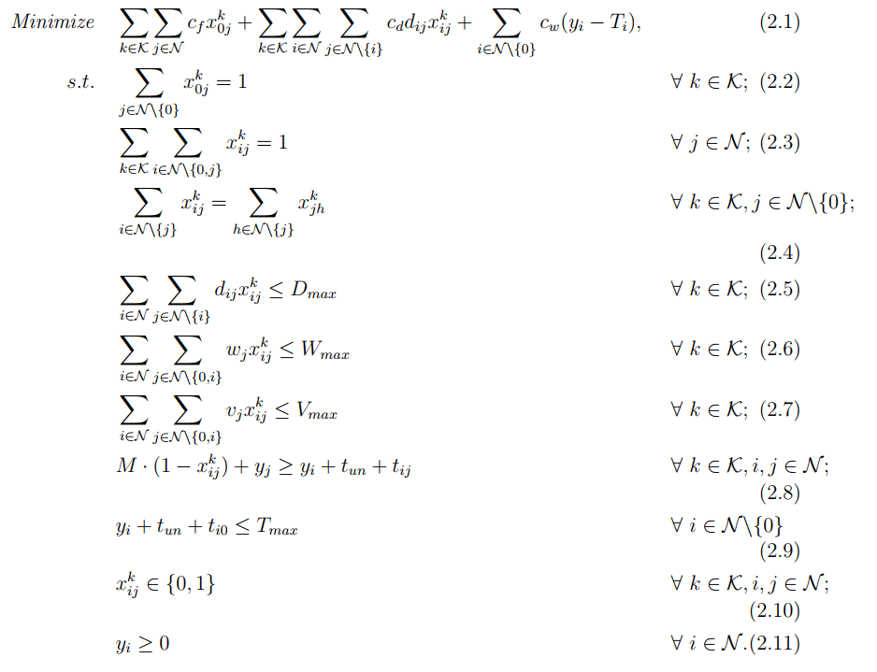
Mathematical model

Slide 13
Anylogic Model

Slide 14
How we code

Slide 15
Future to Do

